Slide 1





1.
A Project Report On
Submitted in partial fulfillment of the requirement for the award of the degree
Bachelor of Computer Application (BCA)
Academic Year 2023 – 24
(Divy Palejiya) 92200527240
(Divyesh Gangah) 92200527243
(Aryan Ponkiya) 92200527253
Internal Guide
(Prof. Shivaniba Bhadoriya)
Rajkot-Morbi Road, At & PO : Gauridad, Rajkot 360 003. Gujarat. India.

Slide 2

Faculty of Computer Applications (FCA)
This is to certify that the project work entitled
Employee Management
submitted in partial fulfillment of the requirement for the award of the degree of
Bachelor of Computer Application
of the
Marwadi University
is a result of the bonafide work carried out by
Divy Palejiya(92200527240)
Divyesh Gangah(92200527243) Aryan Ponkiya(92200527253)
during the academic year 2023-24
Shivaniba Bhadoriya
Sunil Bajeja
Shridharan Sir
Faculty Guide |  | HOD |  | Dean

Slide 3
DECLARATION
I/We hereby declare that this project work entitled Employee Management System is a record done by me.
I also declare that the matter embodied in this project is genuine work done by me and has not been submitted whether to this University or to any other University / Institute for the fulfillment of the requirement of any course of study.
Place : Marwadi University – Rajkot Date : 10/4/2024
Signature : Divy
Signature: Divyesh
Divy Palejiya (92200527240)
Divyesh Gangah (92200527243)
Aryan Ponkiya (92200527253)
Signature: Aryan

Slide 4
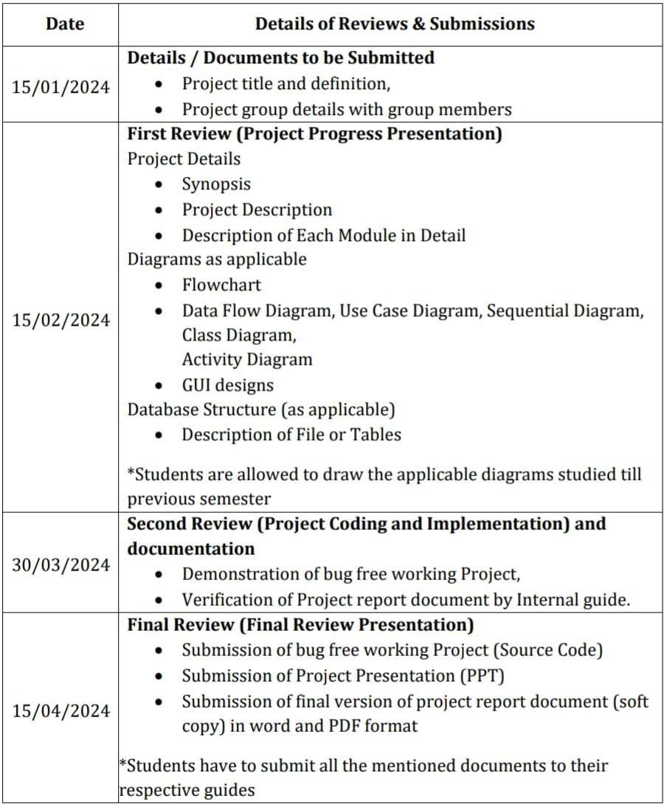
CONTENTS

Slide 5
1. PROJECT DETAILS
1.1 SYNOPSIS
The Employee management system is a software that shows you all information about entered employee detail. Our project aims to create an interactive and informative digital employee management system that stores all entered employee information. We save employee’s ID, Name, Department, Joining Date, Gender, Salary and many other things about employee. And after that you can Remove/Delete the this that you want.
1.2 PROJECT DISCRIPTION
The Employee management system is designed to get all information about entered employee detail. It saves more employee than a simple employee system. It is useful to save all information about employee and make changes on it. Many companies can use this management system and manage their all employee. It saves employee’s ID, Name, Department, Joining Date, Gender, Salary and many other things about employee. And after that you can Remove/Delete the this that you want.

Slide 6
1.2 DESCRIPTION OF MODUEL
Main Method (main method):
  Responsible for initializing the database (Database.dbInit()) before launching the Swing application.
  Launches the main window (Employee Management class).
Employee Management Class:
  Represents the main class for the Employee Management System.
  Initializes the main JFrame and handles the overall organization of the GUI components.
Initialization (initialize method):
  Sets up the main JFrame for the application, including its title, size, and layout.
  Creates and configures UI components such as text fields, labels, buttons, and the JTable.
Input Panel:
  Contains input fields for entering employee details (ID, name, department, etc.).
  Provides buttons for inserting and updating employee records.
  Displays a title at the top using a JTextArea.

Slide 7
2. DIAGRAM AS APPLICABLE
2.1 ALGORITHM AND FLOWCHART
Algorithm
Step 1: Start.
↓
Step 2: Enter employee info that you want to find (Otherwise go to step).
↓
Step 3: Print the employee detail
↓
Step 4: Get all information about employee.
↓
Step 5: End

Slide 8












FLOWCHART
Start
Enter employee Detail
Find the employee information that you want
Print the all employee details
that you want
End

Slide 9



DATAFLOW DIAGRAM
Employee Name
Add Employee
Employee ID
Employee Managemen t System
Add Salary
Login
Employee Account

Slide 10








USECASE DIAGRAM
Employee name
Add employee
Add salary
Employee account
Login
Employee ID

Slide 11
SEQUENTIAL DIAGRAM
Employee
System Manager
Admin
Provide Details
Provide Details
Creat
e Account
Log In
Authenicate
Request to modify/remove account
Forward Request
Update/Delet
e Account

Slide 12
CLASS DIAGRAM
Salary
EmpID : String TotalAmount : String SalaryDeducts : double SalaryAdvance : Double
+ GetSalInfo() + GrossSal()
Employee
EmpID : String EmpName : String ContactNo : String Email : String
+ ViewSalSheet() ViewAttendance()
Admin
AdminID : String
AdminName : String
+ AddEntries ()
+ UpdateEntries()
+ DeleteEntries()
Employee Account
AccountID : String Type : String AccountNo : String
+ Update()
Add Employee
EmpID : String EmpName : String ContactNo : String Email : String
+ Insert() +Update()
Login
EmpID : String Password : String
+ Access() + Varification()

Slide 13
ACTIVITY DIAGRAM
EMPLOYEE
Login
Verify
Account
Apply Leave
Reports
Change Password
Leave Report
Salary
Leave
LogOut

Slide 14
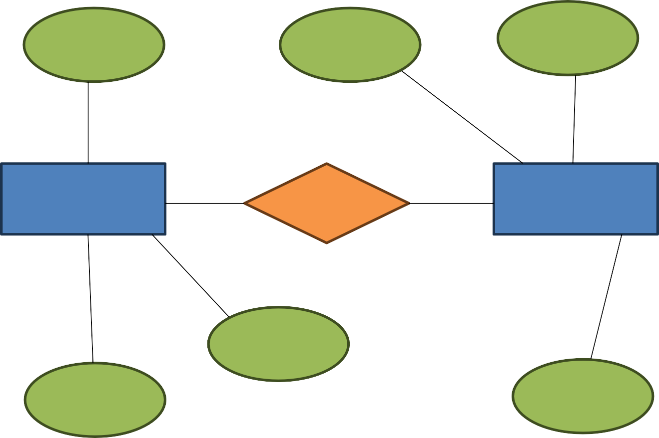
Entity Relationship Diagram
Email
ID
Username
Employee
Has
Login
Name
Phone
Password

Slide 15
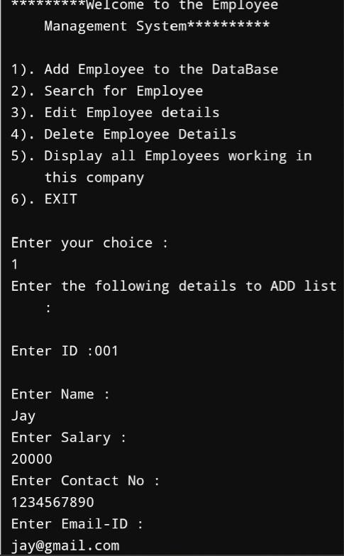
OUTPUT OF THE PROGRAM

Slide 16
TESTCASES FOR THE MINI PROJECT
1. Select your choice
Here you can choose 6 different type of choice.
2. Choice one
Input – “1”
Output – You can add the new employee details in the management system.
3. Enter ID
Input – “ID”
Output – Here you can add id no. of an employee.

Slide 17
4. Enter Name
Input – “Name”
Output – Here you can save the employee full name.
5. Enter Salary
Input – “Salary in Rupees”
Output – Here you can add employee salary in Rupees.
6. Enter Contact No.
Input – “Contact No”
Output – Here you can add and save employee contact no.

Slide 18
7. Enter email-ID
Input – “Enter email-id”
Output – Here you can add employee’s email-id.
8. Choice two
Here you can search for employee that work in your company.
9. Choice two
Input – “Any employee’s ID.
Output – If you write any employee’s id, this project show you that employee’s all details.

Slide 19
10. Choice three
Here you can change any employee’s ID, Name, Salary, Contact no, Email ID.
11. Choice four
Here you can remove any employee’s details.
12. Choice five
Input – “Choice five”
Output – It will show you all the employee’s details that work in your company.

Slide 20
13. Choice six
Input – “Choice six”
Output – If you choose choice six, You close your work/this project.

Slide 21
LEARNING DURING PROJECT
Choose a simple project
  Select a small project idea is that aligns with your current level of Java language knowledge. Example could include a Employee Management System.
Study Relevant Concepts
  As you encounter new concepts and functions, refer to Java language documentation, textbooks, or online tutorials to understand them batter. Topics like variables, loops and functions are essential.
Write code incrementally
  Start with the basics and build your project incrementally. Test each part as you go to ensure it works before moving on to the next.
Debugging
  Debugging is a important part of the learning process. When you encounter errors, use debugging tools and print statements to identify and fix them.
Share and Discuss
  Share your project with others, whether it’s friends, mentors, or online communities. Discussing your code can lead to valuable insights and suggestions for improvement.

Slide 22
BIBLIOGRAPHY
Online Refrances
  “Javatutorial” → W3Schools, Javapoint
  YouTube → ‘Codewithherry’

Slide 23
THANK YOU
(Specially, To our project guide Shivaniba Bhadoriya)

